Slide 1
Angular 1.6 with Typescript
Building a Contact Manager Application
By Yitzchak Meirovich

Slide 2
gulp.js
Gulp is a task runner
Uses Node.js and NPM
Install globally
Will be responsible for compiling and running your project

Slide 3
Resource Dependencies
Gulp plus libraries
Typescript
Http-server
Browserify
Angular.js 1.6
Bootstrap / SCSS

Slide 4
Node/NPM
Create new project folder
Open CMD / Terminal and cd to new folder
Type node -v to check installation
Type nom -v to check installation
Make sure you have the latest version of each

Slide 5
Project Folder
cmd / terminal
> mkdir proj
> cd proj
> mkdir src
> mkdir dist
> npm init

Slide 6
Gulp
Command
> npm install --global gulp-cli
> npm install --save-dev gulp
create gulpfile.js
var gulp = require('gulp')
gulp.task('default', function() {
console.log(‘my first gulp task’);
});
> gulp

Slide 7
Typescript
> npm install --save-dev typescript@1.8.0 gulp gulp-typescript

Slide 8
TS Example 1
In project root create tsconfig.js
{
"files": [
"src/main.ts"
],
"compilerOptions": {
"noImplicitAny": true,
"target": "es5"
}
}

Slide 9
tsconfig options
{
"compilerOptions": {
/* Basic Options */
"target": "es5", /* Specify ECMAScript target version: 'ES3' (default), 'ES5', 'ES2015', 'ES2016', 'ES2017', or 'ESNEXT'. */
"module": "commonjs", /* Specify module code generation: 'commonjs', 'amd', 'system', 'umd' or 'es2015'. */
"lib": [], /* Specify library files to be included in the compilation: */
"allowJs": true, /* Allow javascript files to be compiled. */
"checkJs": true, /* Report errors in .js files. */
"jsx": "preserve", /* Specify JSX code generation: 'preserve', 'react-native', or 'react'. */
"declaration": true, /* Generates corresponding '.d.ts' file. */
"sourceMap": true, /* Generates corresponding '.map' file. */
"outFile": "./", /* Concatenate and emit output to single file. */
"outDir": "./", /* Redirect output structure to the directory. */
"rootDir": "./", /* Specify the root directory of input files. Use to control the output directory structure with --outDir. */
"removeComments": true, /* Do not emit comments to output. */
"noEmit": true, /* Do not emit outputs. */
"importHelpers": true, /* Import emit helpers from 'tslib'. */
"downlevelIteration": true, /* Provide full support for iterables in 'for-of', spread, and destructuring when targeting 'ES5' or 'ES3'. */
"isolatedModules": true, /* Transpile each file as a separate module (similar to 'ts.transpileModule'). */
/* Strict Type-Checking Options */
"strict": true, /* Enable all strict type-checking options. */
"noImplicitAny": true, /* Raise error on expressions and declarations with an implied 'any' type. */
"strictNullChecks": true, /* Enable strict null checks. */
"noImplicitThis": true, /* Raise error on 'this' expressions with an implied 'any' type. */
"alwaysStrict": true, /* Parse in strict mode and emit "use strict" for each source file. */
/* Additional Checks */
"noUnusedLocals": true, /* Report errors on unused locals. */
"noUnusedParameters": true, /* Report errors on unused parameters. */
"noImplicitReturns": true, /* Report error when not all code paths in function return a value. */
"noFallthroughCasesInSwitch": true, /* Report errors for fallthrough cases in switch statement. */
/* Module Resolution Options */
"moduleResolution": "node", /* Specify module resolution strategy: 'node' (Node.js) or 'classic' (TypeScript pre-1.6). */
"baseUrl": "./", /* Base directory to resolve non-absolute module names. */
"paths": {}, /* A series of entries which re-map imports to lookup locations relative to the 'baseUrl'. */
"rootDirs": [], /* List of root folders whose combined content represents the structure of the project at runtime. */
"typeRoots": [], /* List of folders to include type definitions from. */
"types": [], /* Type declaration files to be included in compilation. */
"allowSyntheticDefaultImports": true, /* Allow default imports from modules with no default export. This does not affect code emit, just typechecking. */
/* Source Map Options */
"sourceRoot": "./", /* Specify the location where debugger should locate TypeScript files instead of source locations. */
"mapRoot": "./", /* Specify the location where debugger should locate map files instead of generated locations. */
"inlineSourceMap": true, /* Emit a single file with source maps instead of having a separate file. */
"inlineSources": true, /* Emit the source alongside the sourcemaps within a single file; requires '--inlineSourceMap' or '--sourceMap' to be set. */
/* Experimental Options */
"experimentalDecorators": true, /* Enables experimental support for ES7 decorators. */
"emitDecoratorMetadata": true /* Enables experimental support for emitting type metadata for decorators. */
}
}

Slide 10
tsconfig options
"outDir": "./", /* Redirect output structure to the directory. */
"rootDir": "./", /* Specify the root directory of input files. Use to control the output directory structure with --outDir. */
"removeComments": true, /* Do not emit comments to output. */
"noEmit": true, /* Do not emit outputs. */
"importHelpers": true, /* Import emit helpers from 'tslib'. */
"downlevelIteration": true, /* Provide full support for iterables in 'for-of', spread, and destructuring when targeting 'ES5' or 'ES3'. */
"isolatedModules": true, /* Transpile each file as a separate module (similar to 'ts.transpileModule'). */
/* Strict Type-Checking Options */
"strict": true, /* Enable all strict type-checking options. */
"noImplicitAny": true, /* Raise error on expressions and declarations with an implied 'any' type. */
"strictNullChecks": true, /* Enable strict null checks. */
"noImplicitThis": true, /* Raise error on 'this' expressions with an implied 'any' type. */
"alwaysStrict": true, /* Parse in strict mode and emit "use strict" for each source file. */
/* Additional Checks */
"noUnusedLocals": true, /* Report errors on unused locals. */
"noUnusedParameters": true, /* Report errors on unused parameters. */
"noImplicitReturns": true, /* Report error when not all code paths in function return a value. */
"noFallthroughCasesInSwitch": true, /* Report errors for fallthrough cases in switch statement. */
/* Module Resolution Options */
"moduleResolution": "node", /* Specify module resolution strategy: 'node' (Node.js) or 'classic' (TypeScript pre-1.6). */
"baseUrl": "./", /* Base directory to resolve non-absolute module names. */
"paths": {}, /* A series of entries which re-map imports to lookup locations relative to the 'baseUrl'. */
"rootDirs": [], /* List of root folders whose combined content represents the structure of the project at runtime. */
"typeRoots": [], /* List of folders to include type definitions from. */
"types": [], /* Type declaration files to be included in compilation. */
"allowSyntheticDefaultImports": true, /* Allow default imports from modules with no default export. This does not affect code emit, just typechecking. */
/* Source Map Options */
"sourceRoot": "./", /* Specify the location where debugger should locate TypeScript files instead of source locations. */
"mapRoot": "./", /* Specify the location where debugger should locate map files instead of generated locations. */
"inlineSourceMap": true, /* Emit a single file with source maps instead of having a separate file. */
"inlineSources": true, /* Emit the source alongside the sourcemaps within a single file; requires '--inlineSourceMap' or '--sourceMap' to be set. */
/* Experimental Options */
"experimentalDecorators": true, /* Enables experimental support for ES7 decorators. */
"emitDecoratorMetadata": true /* Enables experimental support for emitting type metadata for decorators. */
}
}

Slide 11
tsconfig options
"noImplicitThis": true, /* Raise error on 'this' expressions with an implied 'any' type. */
"alwaysStrict": true, /* Parse in strict mode and emit "use strict" for each source file. */
/* Additional Checks */
"noUnusedLocals": true, /* Report errors on unused locals. */
"noUnusedParameters": true, /* Report errors on unused parameters. */
"noImplicitReturns": true, /* Report error when not all code paths in function return a value. */
"noFallthroughCasesInSwitch": true, /* Report errors for fallthrough cases in switch statement. */
/* Module Resolution Options */
"moduleResolution": "node", /* Specify module resolution strategy: 'node' (Node.js) or 'classic' (TypeScript pre-1.6). */
"baseUrl": "./", /* Base directory to resolve non-absolute module names. */
"paths": {}, /* A series of entries which re-map imports to lookup locations relative to the 'baseUrl'. */
"rootDirs": [], /* List of root folders whose combined content represents the structure of the project at runtime. */
"typeRoots": [], /* List of folders to include type definitions from. */
"types": [], /* Type declaration files to be included in compilation. */
"allowSyntheticDefaultImports": true, /* Allow default imports from modules with no default export. This does not affect code emit, just typechecking. */
/* Source Map Options */
"sourceRoot": "./", /* Specify the location where debugger should locate TypeScript files instead of source locations. */
"mapRoot": "./", /* Specify the location where debugger should locate map files instead of generated locations. */
"inlineSourceMap": true, /* Emit a single file with source maps instead of having a separate file. */
"inlineSources": true, /* Emit the source alongside the sourcemaps within a single file; requires '--inlineSourceMap' or '--sourceMap' to be set. */
/* Experimental Options */
"experimentalDecorators": true, /* Enables experimental support for ES7 decorators. */
"emitDecoratorMetadata": true /* Enables experimental support for emitting type metadata for decorators. */
}
}

Slide 12
tsconfig options
"typeRoots": [], /* List of folders to include type definitions from. */
"types": [], /* Type declaration files to be included in compilation. */
"allowSyntheticDefaultImports": true, /* Allow default imports from modules with no default export. This does not affect code emit, just typechecking. */
/* Source Map Options */
"sourceRoot": "./", /* Specify the location where debugger should locate TypeScript files instead of source locations. */
"mapRoot": "./", /* Specify the location where debugger should locate map files instead of generated locations. */
"inlineSourceMap": true, /* Emit a single file with source maps instead of having a separate file. */
"inlineSources": true, /* Emit the source alongside the sourcemaps within a single file; requires '--inlineSourceMap' or '--sourceMap' to be set. */
/* Experimental Options */
"experimentalDecorators": true, /* Enables experimental support for ES7 decorators. */
"emitDecoratorMetadata": true /* Enables experimental support for emitting type metadata for decorators. */
}
}

Slide 13
TS Example 1
Create in project root gulpfile.js
var gulp = require("gulp");
var ts = require("gulp-typescript");
var tsProject = ts.createProject("tsconfig.json");
gulp.task("default", function () {
return tsProject.src()
.pipe(tsProject())
.js.pipe(gulp.dest("dist"));
});

Slide 14
TS Example 1
Test the app
> gulp
> node dist/main.js

Slide 15
Gulp Fn’s
gulp.src(globs[, options])
Emits files matching provided glob or an array of globs. Returns a stream of Vinyl files that can be piped to plugins.

Slide 16
Gulp Fn’s
gulp.src(globs[, options])
Emits files matching provided glob or an array of globs. Returns a stream of Vinyl files that can be piped to plugins.
globs
Type: String or Array
Glob or array of globs to read. Globs use node-glob syntax except that negation is fully supported.
A glob that begins with ! excludes matching files from the glob results up to that point. For example, consider this directory structure:
gulp.src(['client/*.js', '!client/b*.js', ‘client/bad.js']) // matches a.js and bad.js

Slide 17
Gulp Fn’s
gulp.dest(path[, options])
Can be piped to and it will write files. Re-emits all data passed to it so you can pipe to multiple folders. Folders that don't exist will be created.
gulp.src('./client/templates/*.jade')
.pipe(jade())
.pipe(gulp.dest('./build/templates'))
.pipe(minify())
.pipe(gulp.dest('./build/minified_templates'));

Slide 18
Gulp Fn’s
gulp.task(name [, deps] [, fn])
Define a task to run
gulp.task('mytask', ['array', 'of', 'task', 'names'], function() {
// Do stuff
});

Slide 19
Gulp Fn’s
gulp.watch(glob[, opts], tasks)
glob
Type: String or Array
A single glob or array of globs that indicate which files to watch for changes.
gulp.watch('js/**/*.js', function(event) {
console.log('File ' + event.path + ' was ' + event.type + ', running tasks...');
});
var watcher = gulp.watch('js/**/*.js', ['uglify','reload']);
watcher.on('change', function(event) {
console.log('File ' + event.path + ' was ' + event.type + ', running tasks...');
});

Slide 20
TS Ex 2
Create file /src/greet.ts
export function sayHello(name: string) {
return `Hello from ${name}`;
}

Slide 21
TS Ex 2
Change /src/main.ts
import { sayHello } from "./greet";
console.log(sayHello("TypeScript"));

Slide 22
TS Ex 2
Change tsconfig.js
{
"files": [
"src/main.ts",
"src/greet.ts"
],
"compilerOptions": {
"noImplicitAny": true,
"target": "es5"
}
}

Slide 23
TS Ex 2
Test
> gulp
> node dist/main.js

Slide 24
Browserify
> npm install --save-dev browserify tsify vinyl-source-stream
Create /src/index.html

Slide 25
TS Ex 3
/src/index.html
<!DOCTYPE html>
<html>
<head>
<meta charset="UTF-8" />
<title>Hello World!</title>
</head>
<body>
<p id="greeting">Loading ...</p>
<script src="bundle.js"></script>
</body>
</html>

Slide 26
TS Ex 3
Change /src/main.ts
import { sayHello } from "./greet";
function showHello(divName: string, name: string) {
const elt = document.getElementById(divName);
elt.innerText = sayHello(name);
}
showHello("greeting", "TypeScript");

Slide 27
TS Ex 3
Change gulpfile.js
var gulp = require("gulp");
var browserify = require("browserify");
var source = require('vinyl-source-stream');
var tsify = require("tsify");
var paths = {
pages: ['src/*.html']
};
gulp.task("copy-html", function () {
return gulp.src(paths.pages)
.pipe(gulp.dest("dist"));
});
gulp.task("default", ["copy-html"], function () {
return browserify({
basedir: '.',
debug: true,
entries: ['src/main.ts'],
cache: {},
packageCache: {}
})
.plugin(tsify)
.bundle()
.pipe(source('bundle.js'))
.pipe(gulp.dest("dist"));
});

Slide 28
TS Ex 3
Open dist/index.html in a browser
You should see “Hello from TypeScript” on the page.

Slide 29
Watchify, Babel, and Uglify
• Watchify starts gulp and keeps it running, incrementally compiling whenever you save a file. This lets you keep an edit-save-refresh cycle going in the browser.
• Babel is a hugely flexible compiler that converts ES2015 and beyond into ES5 and ES3. This lets you add extensive and customized transformations that TypeScript doesn’t support.
• Uglify compacts your code so that it takes less time to download.
> npm install --save-dev watchify gulp-util

Slide 30
Watchify
var gulp = require("gulp");
var browserify = require("browserify");
var source = require('vinyl-source-stream');
var watchify = require("watchify");
var tsify = require("tsify");
var gutil = require("gulp-util");
var paths = {
pages: ['src/*.html']
};
var watchedBrowserify = watchify(browserify({
basedir: '.',
debug: true,
entries: ['src/main.ts'],
cache: {},
packageCache: {}
}).plugin(tsify));
gulp.task("copy-html", function () {
return gulp.src(paths.pages)
.pipe(gulp.dest("dist"));
});
function bundle() {
return watchedBrowserify
.bundle()
.pipe(source('bundle.js'))
.pipe(gulp.dest("dist"));
}
gulp.task("default", ["copy-html"], bundle);
watchedBrowserify.on("update", bundle);
watchedBrowserify.on("log", gutil.log);

Slide 31
Uglify
> npm install --save-dev gulp-uglify vinyl-buffer gulp-sourcemaps

Slide 32
Babel
npm install --save-dev babelify babel-preset-es2015 vinyl-buffer gulp-sourcemaps

Slide 33
TS Ex 3
Modify tsconfig.json
{
"files": [
"src/main.ts"
],
"compilerOptions": {
"noImplicitAny": true,
"target": "es2015"
}
}

Slide 34
TS Ex 3
var gulp = require('gulp');
var browserify = require('browserify');
var source = require('vinyl-source-stream');
var tsify = require('tsify');
var sourcemaps = require('gulp-sourcemaps');
var buffer = require('vinyl-buffer');
var paths = {
pages: ['src/*.html']
};
gulp.task('copyHtml', function () {
return gulp.src(paths.pages)
.pipe(gulp.dest('dist'));
});
gulp.task('default', ['copyHtml'], function () {
return browserify({
basedir: '.',
debug: true,
entries: ['src/main.ts'],
cache: {},
packageCache: {}
})
.plugin(tsify)
.transform('babelify', {
presets: ['es2015'],
extensions: ['.ts']
})
.bundle()
.pipe(source('bundle.js'))
.pipe(buffer())
.pipe(sourcemaps.init({loadMaps: true}))
.pipe(sourcemaps.write('./'))
.pipe(gulp.dest('dist'));
});

Slide 35
Project
Build two-page SPA using
Angular 1.6
Typescript 1.8
Bootstrap 3
jQuery
Gulp, Browserify

Slide 36
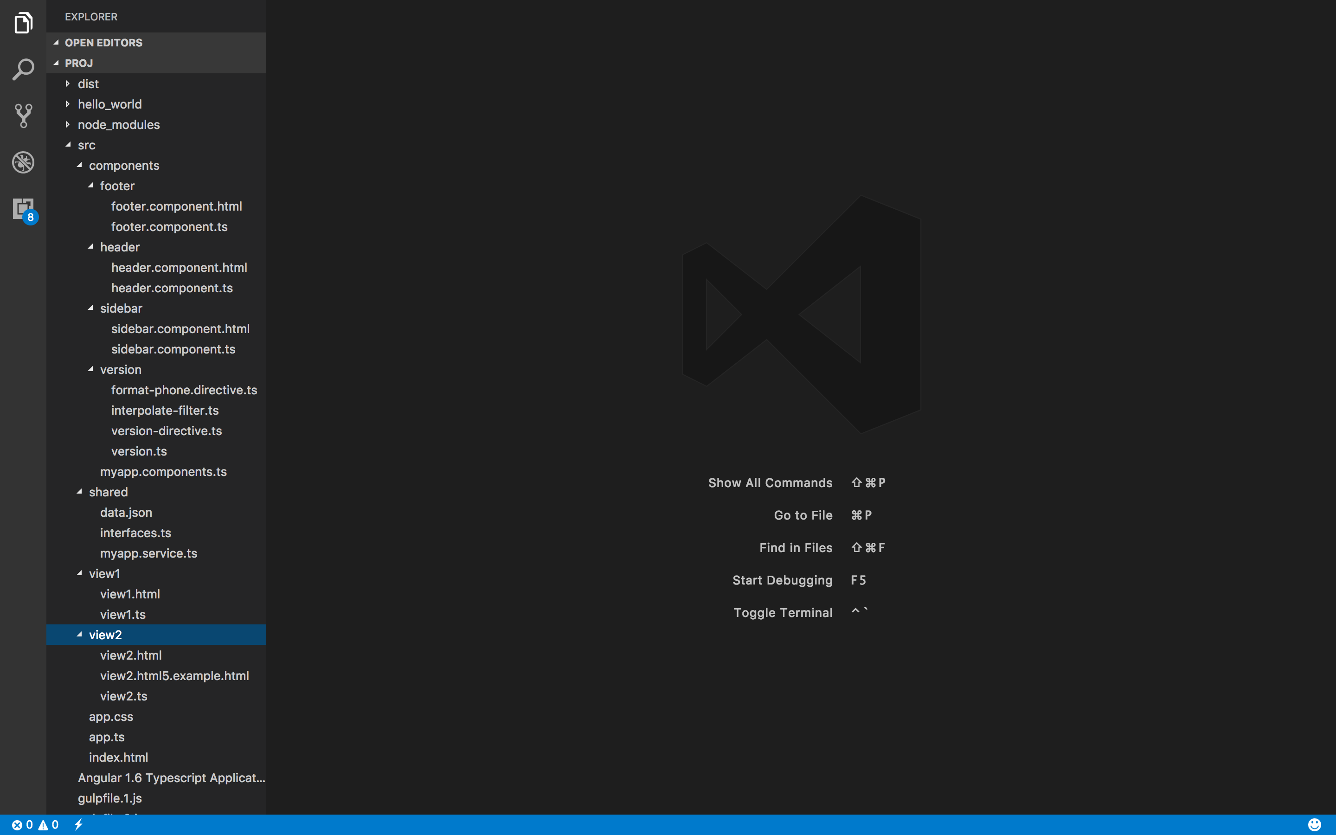
Folders/Files

Slide 37
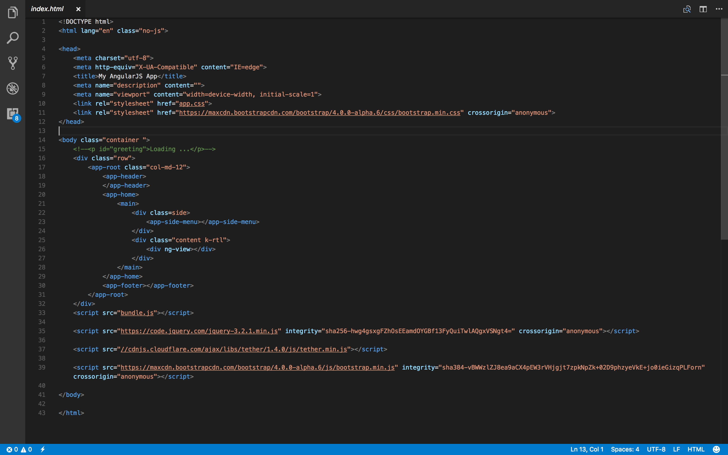

Slide 38
App.css
html,
body {
height: 100%;
}
app-root {
display: flex;
height: 100vh;
flex-direction: column;
}
app-root app-header {
flex: 0 0 70px;
}
app-root app-header header {
height: 100%;
}
app-root app-home {
flex: 1 0 auto;
display: flex;
}
app-root app-home main {
display: flex;
}
app-root app-home main .side {
flex: 0 0 110px;
}
app-root app-home main .content {
flex: 1 0 auto;
}
app-root app-footer {
flex: 0 0 35px;
}
app-root app-footer footer {
height: 100%;
}
tr:nth-child(even):hover {
background: #CCC
}
tr:nth-child(odd) {
background: #FFF
}
input[type="tel"] {
border: 1px solid #ddd;
padding: 4px 8px;
}
input[type="tel"]:focus {
border: 1px solid #000;
}
.has-error {
border: 1px solid red;
}
.help-block {
color: red;
}

Slide 39
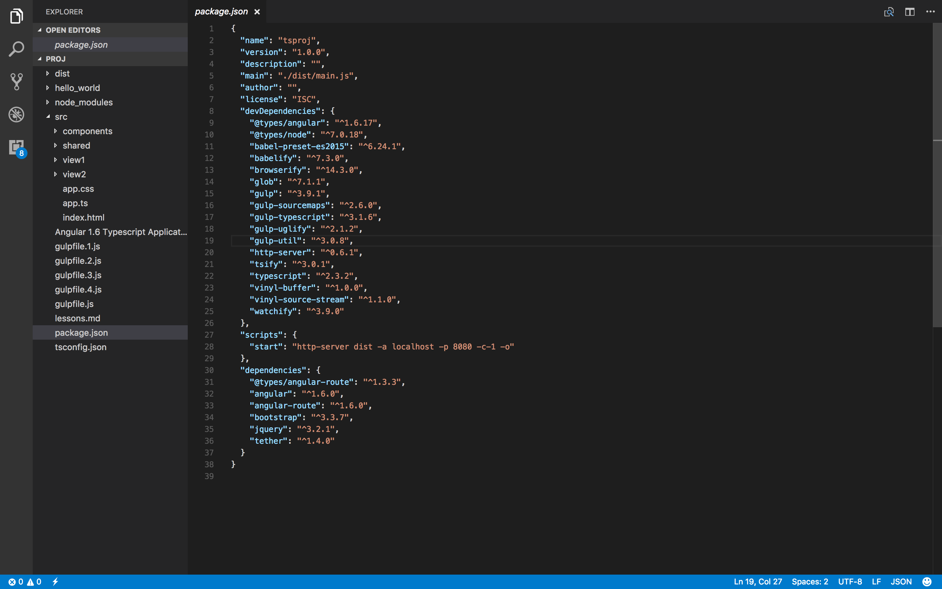

Slide 40
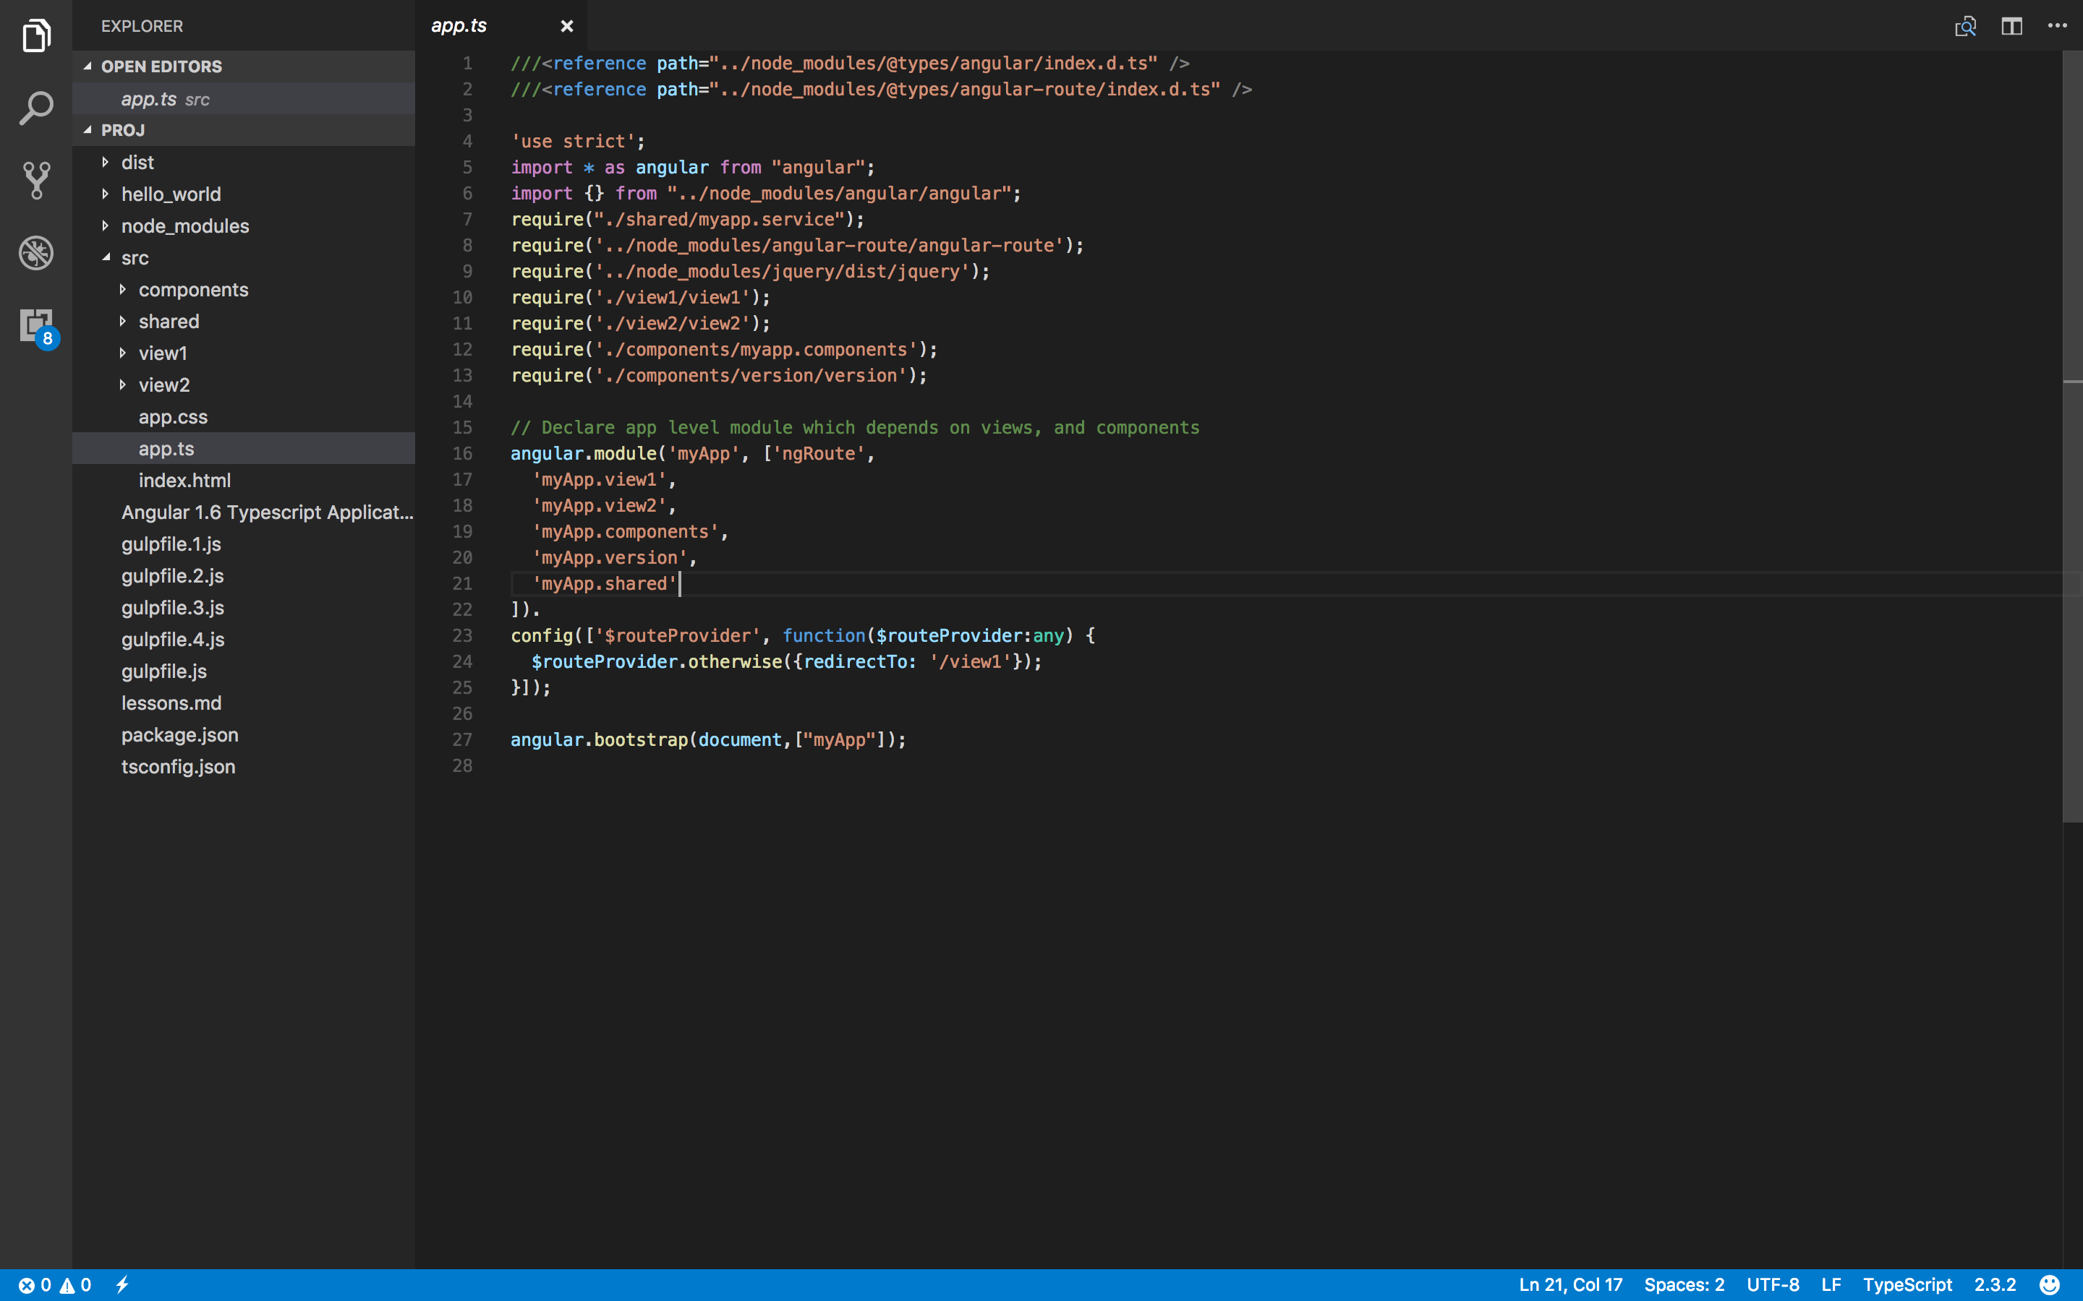

Slide 41
Lesson 1
Create and Load the first page, View1.html
Bind data to the view, View1.ts
Add routing
Load the app.module, app.ts

Slide 42
Lesson 1
app.ts
///<reference path="../node_modules/@types/angular/index.d.ts" />
///<reference path="../node_modules/@types/angular-route/index.d.ts" />
'use strict';
import * as angular from "angular";
import {} from "../node_modules/angular/angular";
require('../node_modules/angular-route/angular-route');
require('../node_modules/jquery/dist/jquery');
require(‘./view1/view1');
require('./components/myapp.components');
// Declare app level module which depends on views, and components
angular.module('myApp', ['ngRoute',
‘myApp.view1',
'myApp.components',
'myApp.shared'
]).
config(['$routeProvider', function($routeProvider:any) {
$routeProvider.otherwise({redirectTo: '/view1'});
}]);
angular.bootstrap(document,["myApp"]);

Slide 43
Lesson 1
View1.html
<div class="row">
<div class="col-md-12">
<div class="text-center">
<h1>{{PageTitle}}</h1>
</div>
</div>
</div>
<div class="row">
<div class="col-md-12">
<p>
<button id="btn" class="btn btn-primary" >
<span ng-bind="AddRecordText"></span>
</button>
</p>
</div>
</div>

Slide 44
Lesson 1
View1.html
<div class="row">
<div class="col-md-12">
<table>
<thead>
<th>First Name</th>
<th>Last Name</th>
<th>Phone</th>
<th>Email</th>
<th>Action</th>
</thead>
<tbody>
<tr >
<td>FirstName1</td>
<td>LastName2</td>
<td>Phone3</td>
<td>Email4</td>
<td>
<button type="button" class="btn btn-info btn-sm">
<span class="" >Edit</span>
</button>
<button type="button" class="btn btn-danger btn-sm">
<span class="" >Trash</span>
</button>
</td>
</tr>
</tbody>
</table>
</div>
</div>

Slide 45
Lesson 1
View1.ts
///<reference path="../../node_modules/@types/angular/index.d.ts" />
///<reference path="../../node_modules/@types/angular-route/index.d.ts" />
'use strict';
import * as angular from "angular";
import { IContactRecord } from "../shared/interfaces";
import * as DataMgr from "../shared/myapp.service";

Slide 46
Lesson 1
View1.ts
angular.module('myApp.view1', ['ngRoute'])
.config(['$routeProvider', function ($routeProvider: any) {
$routeProvider.when('/view1', {
templateUrl: 'view1/view1.html',
controller: 'View1Ctrl',
controllerAs: 'ctrl'
}) }])
.controller('View1Ctrl', ContactsHomePageModule.View1Controller);

Slide 47
Lesson 1
View1.ts
module ContactsHomePageModule {
export interface IContactFieldsScope extends ng.IScope, IContactRecord {
PageTitle: string;
AddRecordText: string;
ContactRecords: IContactRecord[];
}
export class View1Controller {
static $inject = ["$scope", "$location", "DataMgr"];
constructor(protected $scope: ContactsHomePageModule.IContactFieldsScope,
private $location: ng.ILocationService) {
$scope.PageTitle = "Contact Home Page";
$scope.AddRecordText = "New Contact" }
}
}

Slide 48
Lesson 1
interfaces.ts
export interface IContactRecord {
id?:number;
FirstName?: string;
LastName?: string;
Phone?: number;
Email?: string;
}

Slide 49
Lesson 2
Bind data to the data grid

Slide 50
Lesson 2
View1.ts
export class View1Controller {
private data: IContactRecord[] = [{
id:1,
FirstName: 'fasd',
LastName: 'dasd',
Phone: 2222,
Email: 'sd'
}, {
id:2,
FirstName: 'wwewewe',
LastName: 'dasrrrrd',
Phone: 6666,
Email: '@dfdfgdfg'
}];
constructor(protected $scope: ContactsHomePageModule.IContactFieldsScope,
private $location: ng.ILocationService,
private dataMgr: DataMgr.myService.DataMgr) {
$scope.PageTitle = "Contact Home Page";
$scope.AddRecordText = "New Contact"
$scope.ContactRecords = this.data
this.loadData();
}

Slide 51
Lesson 2
View1.html
<tr ng-repeat="contact in ContactRecords track by $index">
<td>{{contact.FirstName}}</td>
<td>{{contact.LastName}}</td>
<td>{{contact.Phone}}</td>
<td>{{contact.Email}}</td>

Slide 52
Lesson 3
Build Sidebar, Header, Footer

Slide 53
Lesson 3
sidebar.component.html
<ul class="">
<li><a href="#!/view1">Home Page</a></li>
<li><a href="#!/view2">Contact Form</a></li>
</ul>

Slide 54
Lesson 3
sidebar.componet.ts
'use strict'
import {IHttpService, IPromise} from 'angular';
export class SideMenuComponentController {
private res:any;
constructor (
private $http: IHttpService
) {}
fetch (url: string): IPromise<string> {
return this.$http.get(url).then(_ => _.data)
}
}
export let SideMenuComponent = {
bindings: {
url: '<'
},
templateUrl : `./components/sidebar/sidebar.component.html` ,
controller: SideMenuComponentController
}

Slide 55
Lesson 4
Register components in myapp.components.ts

Slide 56
Lesson 4
myapp.component.ts
// 'use strict'
import * as angular from “angular";
import {SideMenuComponent} from "./sidebar/sidebar.component";
angular.module('myApp.components', []).component('appSideMenu',SideMenuComponent)

Slide 57
Lesson 5
Build Footer

Slide 58
Lesson 5
footer.component.ts
export class FooterComponentController {
constructor() { }
}
export let FooterComponent = {
bindings: {
url: '<'
},
template: `
<div class="row">
<div class="col-md-12">
<div class="text-center">
<h2>Footer</h2>
</div>
</div>
</div>
`,
controller: FooterComponentController
}

Slide 59
Lesson 5
myapp.components.ts
import * as angular from "angular";
import {FooterComponent} from “./footer/footer.component";
import {SideMenuComponent} from "./sidebar/sidebar.component";
angular.module('myApp.components', [])
.component('appFooter',FooterComponent)
.component('appSideMenu',SideMenuComponent)

Slide 60
Lesson 6
Build Header

Slide 61
Lesson 6
header.component.html
<div class=“row">
<div class="col-md-12">
<div class="text-center">
<h2>Header</h2>
</div>
</div>
</div>

Slide 62
Lesson 6
header.component.ts
export class HeaderComponentController {
constructor( ) {
}
}
export class HeaderComponent implements ng.IComponentOptions {
public bindings: any;
public controller: any;
//public controllerAs: any; //can user $ctrl
public templateUrl: string;
constructor() {
this.bindings = {
textBinding: '@',
dataBinding: '<',
functionBinding: '&'
};
this.controller = HeaderComponentController;
//this.controllerAs = 'ctrl';
this.templateUrl = './components/header/header.component.html';
}
}

Slide 63
Lesson 6
myapp.components.ts
import * as angular from "angular";
import {FooterComponent} from "./footer/footer.component";
import {HeaderComponent} from "./header/header.component";
import {SideMenuComponent} from "./sidebar/sidebar.component";
angular.module('myApp.components', [])
.component('appHeader',new HeaderComponent())
.component('appFooter',FooterComponent)
.component('appSideMenu',SideMenuComponent)

Slide 64
Lesson 7
Build Contact form, View2.html, View2.ts

Slide 65
Lesson 7
View2.html
<div class="container" >
<div class="row">
<div class=“col-md-6">
—-> <form>
</div>
</div>
</div>

Slide 66
Lesson 7
View2.html
<form>
<div class="form-group">
<label for="fname">First Name</label>
<input type="input" class="form-control" id="fname" placeholder="Enter first name" required>
</div>
<div class="form-group">
<label for="lname">Last Name</label>
<input type="input" class="form-control" id="lname" placeholder="Enter last name" required>
</div>
<div class="form-group">
<label for="email">Email address</label>
<input type="email" class="form-control" id="email" aria-describedby="emailHelp" placeholder="Enter email">
<small id="emailHelp" class="form-text text-muted">We'll never share your email with anyone else.</small>
</div>
<div class="form-group">
<label for="phonenum">Phone Number</label><br/>
<input id="phonenum" type="tel" pattern="^\d{4}-\d{3}-\d{4}$" required aria-describedby="phoneHelp">
<small id="phoneHelp" class="form-text text-muted">Enter the following pattern: (format: xxxx-xxx-xxxx)</small>
</div>
<button type="submit" class="btn btn-primary">Submit</button>
</form>

Slide 67
Lesson 7
View2.ts
'use strict';
import * as angular from "angular";
import { IContactRecord } from "../shared/interfaces";
module ContactsForm {
export class TextFieldController {
public hasError: boolean;
public user: IContactRecord;
static $inject = ["$scope","$location"];
constructor(private $scope: ng.IScope,
private $location: ng.ILocationService) {
}
}
}
angular.module('myApp.view2', ['ngRoute'])
.config(['$routeProvider', function ($routeProvider: any) {
$routeProvider.when('/view2', {
templateUrl: 'view2/view2.html',
controller: 'View2Ctrl',
controllerAs: 'ctrl'
});
}])
.controller('View2Ctrl', ContactsForm.TextFieldController);

Slide 68
Lesson 7
app.ts
///<reference path="../node_modules/@types/angular/index.d.ts" />
///<reference path="../node_modules/@types/angular-route/index.d.ts" />
'use strict';
import * as angular from "angular";
import {} from “../node_modules/angular/angular";
require('../node_modules/angular-route/angular-route');
require('../node_modules/jquery/dist/jquery');
require('./view1/view1');
require('./view2/view2');
require('./components/myapp.components');
// Declare app level module which depends on views, and components
angular.module('myApp', ['ngRoute',
'myApp.view1',
'myApp.view2',
‘myApp.components’
]).
config(['$routeProvider', function($routeProvider:any) {
$routeProvider.otherwise({redirectTo: '/view1'});
}]);
angular.bootstrap(document,["myApp"]);

Slide 69
Lesson 8
Bind the view to the controller

Slide 70
Lesson 8
View2.html
<form name="userForm" ng-submit="ctrl.submitForm(ctrl.user)" novalidate>
<input type="hidden" name="id" ng-model="ctrl.user.id" />
<div class="form-group" ng-class="{ 'has-error' : ctrl.hasError }”>
<label for="fname">First Name</label>
<input type="input" class="form-control" id="fname" name="fname" app-version ng-model="ctrl.user.FirstName" placeholder="Enter first name" required>
<p ng-show="(userForm.fname.$invalid && !userForm.fname.$pristine)" class="help-block">Your name is required.</p>
</div>

Slide 71
Lesson 8
View2.html
<div class="form-group" ng-class="{ 'has-error' : ctrl.hasError }”>
<label for="lname">Last Name</label>
<input type="input" class="form-control"
id="lname"
name="lname"
ng-model="ctrl.user.LastName"
ng-change="ctrl.onChange(userForm.lname,userForm)"
placeholder="Enter last name"
required>
</div>

Slide 72
Lesson 8
View2.html
<div class="form-group" ng-class="{ 'has-error' : ctrl.hasError }”>
<label for="email">Email address</label>
<input type="email" class="form-control" id="email" name="email" aria-describedby="emailHelp" ng-model="ctrl.user.Email" placeholder="Enter email" ng-model=“ctrl.email.LastName">
<small id="emailHelp" class="form-text text-muted">We'll never share your email with anyone else.</small>
<p ng-show="(userForm.email.$invalid || (userForm.email.$touched && userForm.email.$viewValue===''))" class="has-error">Email is incorrect</p>
</div>

Slide 73
Lesson 8
View2.ts
onChange(e: any, form): void {
if (e.$viewValue == "") {
this.hasError = true;
form.$setValidity("required", false);
} else {
this.hasError = false;
form.$setValidity("required", true)
}
e.$setViewValue(e.$viewValue);
}
submitForm(form: any): void {
console.log(this);
console.log(form);
this.$location.path("/view1");
}

Slide 74
Lesson 8
View2.html
<form name="userForm" ng-submit="ctrl.submitForm(ctrl.user)" novalidate>
<input type="hidden" name="id" ng-model="ctrl.user.id" />
<div class="form-group" ng-class="{ 'has-error' : ctrl.hasError }">
<label for="fname">First Name</label>
<input type="input" class="form-control" id="fname" name="fname" app-version ng-model="ctrl.user.FirstName" placeholder="Enter first name" required>
<p ng-show="(userForm.fname.$invalid && !userForm.fname.$pristine)" class="help-block">Your name is required.</p>
</div>
<div class="form-group" ng-class="{ 'has-error' : ctrl.hasError }">
<label for="lname">Last Name</label>
<input type="input" class="form-control" id="lname" name="lname" ng-model="ctrl.user.LastName" ng-change="ctrl.onChange(userForm.lname,userForm)" placeholder="Enter last name" required>
</div>
<div class="form-group" ng-class="{ 'has-error' : ctrl.hasError }">
<label for="email">Email address</label>
<input type="email" class="form-control" id="email" name="email" aria-describedby="emailHelp" ng-model="ctrl.user.Email" placeholder="Enter email" ng-model="ctrl.email.LastName">
<small id="emailHelp" class="form-text text-muted">We'll never share your email with anyone else.</small>
<p ng-show="(userForm.email.$invalid || (userForm.email.$touched && userForm.email.$viewValue===''))" class="has-error">Email is incorrect</p>
</div>
<div class="form-group" ng-class="{ 'has-error' : ctrl.hasError }">
<label for="phonenum">Phone Number</label><br/>
<input id="phonenum" name="phonenum" type="tel" pattern="^\d{4}-\d{3}-\d{4}$" format-phone phone-text="ctrl.user.Phone" ng-model="ctrl.user.Phone" required aria-describedby="phoneHelp">
<small id="phoneHelp" class="form-text text-muted">Enter the following pattern: (format: xxxx-xxx-xxxx)</small>
</div>
<button type="submit" ng-disabled="userForm.$invalid" class="btn btn-primary">Submit</button>
</form>

Slide 75
Lesson 9
Debug using F12
Add values to the form
Install Angular Scope Inspector from Chrome Web Store
View the values on the model using the Inspector

Slide 76
Lesson 10
Build Format Phone Directive

Slide 77
Lesson 10
format-phone.directive.ts
'use strict';
module directives {
export function formatPhoneDirective(): ng.IDirective {
return {
restrict: 'A',
require: ['ngModel'],
replace: true,
scope: {
phoneText: "="
},
}
}
angular.module('myApp.version.format-phone.directive', [])
.directive('formatPhone', directives.formatPhoneDirective);

Slide 78
Lesson 10
format-phone.directive.ts
link: (scope: ng.IScope, element: ng.IAugmentedJQuery, attrs: ng.IAttributes, ctrls) => {
console.log(element.val());
var field = scope.$parent.userForm.phonenum;
function format(n: any) {
var arr = [],
nArr = n.split("");
var i = 0;
while (nArr.length !== 0) {
if (i === 1) arr.push(nArr.splice(0, 3).join(""));
else arr.push(nArr.splice(0, 4).join(""));
i++;
}
return arr.join("-");
}
element.on('blur', (e: any) => {
if (e.target.value.length == 11) {
scope.$parent.ctrl.user.Phone = format(e.target.value);
// scope.$apply(() => {
// });
field.$setValidity();
}
})
}
};

Slide 79
Lesson 10
View2.ts
angular.module('myApp.view2', ['ngRoute', 'myApp.version.version-directive'])
.config(['$routeProvider', function ($routeProvider: any) {
$routeProvider.when('/view2', {
templateUrl: 'view2/view2.html',
controller: 'View2Ctrl',
controllerAs: 'ctrl'
});
}])
.controller('View2Ctrl', ContactsForm.TextFieldController);

Slide 80
Lesson 10
version.ts
'use strict';
//
import * as angular from “angular"
require('./format-phone.directive');
angular.module('myApp.version', [
'myApp.version.format-phone.directive'
])

Slide 81
Lesson 11
Build a service to share data between views
The service will make a $http.get request for json data

Slide 82
Lesson 11
myapp.service.ts
'use strict'
import * as angular from "angular";
import { IContactRecord } from './interfaces';
export module myService {
export class DataMgr {
private qService: ng.IQService;
private httpService: ng.IHttpService;
private _contactData: Array<IContactRecord>=[];
static $inject = ['$http',"$q"];
constructor(private $http: ng.IHttpService, private $q: ng.IQService) {
this.httpService = $http;
this.qService = $q;
}
}
}
angular.module('myApp.shared', [])
.service('DataMgr', myService.DataMgr)

Slide 83
Lesson 11
myapp.service.ts
get ContactData(): Array<IContactRecord> {
return this._contactData;
}
set ContactData(val: Array<IContactRecord>) {
this._contactData = val;
}
getData(url:string): ng.IPromise<Object[]> {
var deferred = this.qService.defer();
if(this.ContactData.length===0){
this.httpService.get(url).then((result: any): void => {
if (result.status === 200) {
this.ContactData = result.data;
deferred.resolve(result.data);
} else {
deferred.reject(result);
}
}, error => {
deferred.reject(error);
});
}else{
deferred.resolve(this.ContactData);
}
return deferred.promise;
}
postData(param:any) {
this.ContactData.push(param);
}

Slide 84
Lesson 11
myapp.service.ts
updateData(recordIndex:number, updateRecord:IContactRecord){
this.ContactData[recordIndex] = updateRecord;
}
deleteData(id:number){
this.ContactData.forEach((v:IContactRecord,i:number,arr:IContactRecord[])=>{
if(v.id === id) this.ContactData.splice( i, 1 );
return;
})
}

Slide 85
Lesson 11
app.ts
///<reference path="../node_modules/@types/angular/index.d.ts" />
///<reference path="../node_modules/@types/angular-route/index.d.ts" />
'use strict';
import * as angular from "angular";
import {} from "../node_modules/angular/angular";
require("./shared/myapp.service");
require('../node_modules/angular-route/angular-route');
require('../node_modules/jquery/dist/jquery');
require('./view1/view1');
require('./view2/view2');
require('./components/myapp.components');
require('./components/version/version');
// Declare app level module which depends on views, and components
angular.module('myApp', ['ngRoute',
'myApp.view1',
'myApp.view2',
'myApp.components',
'myApp.version',
'myApp.shared'
]).
config(['$routeProvider', function($routeProvider:any) {
$routeProvider.otherwise({redirectTo: '/view1'});
}]);
angular.bootstrap(document,["myApp"]);

Slide 86
Lesson 12
Make an HTTP call for data and bind it to the grid on View1

Slide 87
Lesson 12
data.json
[{
"id": 1,
"FirstName": "Tom",
"LastName": "Smith",
"Phone": 22229994443,
"Email": "x@z.com"
}, {
"id": 2,
"FirstName": "Mary",
"LastName": "Richardson",
"Phone": 66665554333,
"Email": "c@d.com"
},
{
"id": 3,
"FirstName": "Tom",
"LastName": "Jones",
"Phone": 22223334443,
"Email": "a@b.com"
}
]

Slide 88
Lesson 12
View1.ts
static $inject = ["$scope", "$location", “DataMgr"];
constructor(protected $scope: ContactsHomePageModule.IContactFieldsScope,
private $location: ng.ILocationService,
private dataMgr: DataMgr.myService.DataMgr) {
$scope.PageTitle = "Contact Home Page";
$scope.AddRecordText = "New Contact"
$scope.ContactRecords = this.data
this.loadData();
}
loadData(){
this.dataMgr.getData('shared/data.json')
.then((res:any)=>{
this.$scope.ContactRecords=res;
})
.catch((e:any)=>{
console.log(e);
})
}

Slide 89
Lesson 12
View1.ts
onEdit(id:number){
this.$location.path('/view2/'+id)
}
onDelete(id:number){
this.dataMgr.deleteData(id);
}
onAddNewContact() {
this.$location.path("/view2");
}

Slide 90
Lesson 12
View1.html
<button id="btn" class="btn btn-primary" ng-click="ctrl.onAddNewContact($event)">
<span ng-bind="AddRecordText"></span>
</button>
<button type="button" class="btn btn-info btn-sm">
<span class="" ng-click="ctrl.onEdit(contact.id)">Edit</span>
</button>
<button type="button" class="btn btn-danger btn-sm">
<span class="" ng-click="ctrl.onDelete(contact.id)">Trash</span>
</button>

Slide 91
Lesson 13
Add Routing with Parameters

Slide 92
Lesson 13
View1.ts
angular.module('myApp.view1', ['ngRoute'])
.config(['$routeProvider', function ($routeProvider: any) {
$routeProvider.when('/view1', {
templateUrl: 'view1/view1.html',
controller: 'View1Ctrl',
controllerAs: 'ctrl'
})
.when('/view2/:id',{
templateUrl: 'view2/view2.html',
controller: 'View2Ctrl',
controllerAs: 'ctrl'
});
}])

Slide 93
Lesson 13
Communicate between components with PubSub

Slide 94
Lesson 13
header.component.ts
interface HeaderModel {
fileSaved: string;
}
export class HeaderComponentController {
private _
private res: any;
private model: HeaderModel;
constructor(
private $http: IHttpService,
private $scope: ng.IScope
) {
$scope.$on('fileSaved', (event: ng.IAngularEvent, data: string) => {
this.model = new Model('File Saved');
}
);
}
}
class Model implements HeaderModel {
constructor(
public fileSaved: string
) { }
}

Slide 95
Lesson 13
header.component.html
<div class="row">
<!--Angular seed app: v<span app-version></span>-->
<div class="col-md-12">
<div class="text-center">
<h2>Header</h2>
<span id="fileSaved">{{$ctrl.model.fileSaved}}</span>
</div>
</div>
</div>

Slide 96
Lesson 13
View2.ts
import * as DataMgr from "../shared/myapp.service";
public hasError: boolean;
public user: IContactRecord;
public currentRecord:number;
static $inject = ["$scope", "DataMgr", "$location", "$routeParams","$rootScope"];
constructor(private $scope: ng.IScope,
private dataMgr: DataMgr.myService.DataMgr,
private $location: ng.ILocationService,
private $routeParams: ng.route.IRouteParamsService,
private $rootScope: ng.IRootScopeService) {
}

Slide 97
Lesson 13
View2.ts
submitForm(form: any): void {
console.log(this);
console.log(form);
if (angular.isUndefined(form.id)) {
form.id = Math.round(Math.random() * 100000);
this.dataMgr.postData(form);
}else{
this.dataMgr.updateData(this.currentRecord, form)
}
this.$rootScope.$broadcast("fileSaved",true);
this.$location.path("/view1");
}

Slide 98
Lesson 14
Load selected record from View1 in View2

Slide 99
Lesson 14
View2.ts
onInit(): void {
if (angular.isDefined(this.$routeParams.id)) {
let record = this.dataMgr.ContactData.forEach((v, i, arr) => {
if (v.id === Number(this.$routeParams.id)) {
this.user = new User(v.id, v.FirstName, v.LastName, v.Email, v.Phone);
this.currentRecord = i;
}
})
};
}
class User implements IContactRecord {
constructor(
public id,
public FirstName?,
public LastName?,
public Email?,
public Phone?
) { }
}

Slide 100
Lesson 14
View2.html
<div class="container" ng-init="ctrl.onInit()">

Slide 101
Namespaces
Namespaces provide you with a convenient syntax around a common pattern used in JavaScript:
(function(something) {
something.foo = 123;
})(something || (something = {}))

Slide 102
Namespaces
namespace Utility {
export function log(msg) {
console.log(msg);
}
export function error(msg) {
console.error(msg);
}
}
// usage
Utility.log('Call me');
Utility.error('maybe!');
(function (Utility) {
// Add stuff to Utility
})(Utility || (Utility = {}));

Slide 103
@types
Provides type definitions for 3rd party projects
Ex.
npm install @types/jquery —save-dev
import * as $ from "jquery";
https://github.com/DefinitelyTyped/DefinitelyTyped

Slide 104
Ambient Declarations
• Ambient declarations is a promise that you are making with the compiler. If these do not exist at runtime and you try to use them, things will break without warning.
• Ambient declarations are like docs. If the source changes the docs need to be kept updated. So you might have new behaviours that work at runtime but no one's updated the ambient declaration and hence you get compiler errors.
///<reference path="../../node_modules/@types/angular/index.d.ts" />
///<reference path="../../node_modules/@types/angular-route/index.d.ts" />

Slide 105
Interfaces
Interfaces have zero runtime JS impact. There is a lot of power in TypeScript interfaces to declare the structure of variables.
interface Point {
x: number; y: number;
}
declare var myPoint: Point;
class MyPoint implements Point {
x: number; y: number; // Same as Point
}

Slide 106
Enums
An enum is a way to organize a collection of related values. Many other programming languages (C/C#/Java) have an enum data type but JavaScript does not. However TypeScript does.
enum CardSuit {
Clubs,
Diamonds,
Hearts,
Spades
}
// Sample usage
var card = CardSuit.Clubs;
// Safety
card = "not a member of card suit"; // Error : string is not assignable to type `CardSuit`

Slide 107
Functions
Return type annotation
You can annotate the return type after the function parameter list with the same style as you use for a variable, e.g. : Foo in the below example:
interface Foo {
foo: string;
}
// Return type annotated as `: Foo`
function foo(sample: Foo): Foo {
return sample;
}

Slide 108
Functions
Optional Parameters
You can mark a parameter as optional:
function foo(bar: number, bas?: string): void {
// ..
}
foo(123);
foo(123, 'hello');

Slide 109
Functions
Overloading
function padding(all: number);
function padding(topAndBottom: number, leftAndRight: number);
function padding(top: number, right: number, bottom: number, left: number);
// Actual implementation that is a true representation of all the cases the function body needs to handle
function padding(a: number, b?: number, c?: number, d?: number) {
if (b === undefined && c === undefined && d === undefined) {
b = c = d = a;
}
else if (c === undefined && d === undefined) {
c = a;
d = b;
}
return {
top: a,
right: b,
bottom: c,
left: d
};
}

Slide 110
Type Assertion
TypeScript allows you to override its inferred and analyzed view of types in any way you want to.
This is done by a mechanism called "type assertion".
TypeScript's type assertion is telling the compiler that you know about the types better than it does, and that it should not second guess you.
interface Foo {
bar: number;
bas: string;
}
var foo = {} as Foo;
foo.bar = 123;
foo.bas = 'hello';

Slide 111
Type Assertion
Another form, often thought of as Casting
interface Foo {
bar: number;
bas: string;
}
var foo = <Foo>{
// the compiler will provide autocomplete for properties of Foo
// But it is easy for the developer to forget adding all the properties
// Also this code is likely to break if Foo gets refactored (e.g. a new property added)
};

Slide 112
Generics
The key motivation for generics is to provide meaningful type constraints between members. The members can be:
Class instance members
Class methods
function arguments
function return value

Slide 113
Generics
class Queue {
private data = [];
push = (item) => this.data.push(item);
pop = () => this.data.shift();
}
const queue = new Queue();
queue.push(0);
queue.push("1"); // Ops a mistake
// a developer walks into a bar
console.log(queue.pop().toPrecision(1));
console.log(queue.pop().toPrecision(1)); // RUNTIME ERROR
One issue with this implementation is that it allows people to add anything to the queue and when they pop it - it can be anything.

Slide 114
Generics
/** A class definition with a generic parameter */
class Queue<T> {
private data = [];
push = (item: T) => this.data.push(item);
pop = (): T => this.data.shift();
}
/** Again sample usage */
const queue = new Queue<number>();
queue.push(0);
queue.push("1"); // ERROR : cannot push a string. Only numbers allowed
Convention of T
All items T take on the param type

Slide 115
Type Inference
TypeScript can infer (and then check) the type of a variable based on a few simple rules.
let foo = 123; // foo is a `number`
let bar = "Hello"; // bar is a `string`
foo = bar; // Error: cannot assign `string` to a `number`
function add(a: number, b: number) {
return a + b; //inferred to return a number b/c of the params
}

Slide 116
The End

